Slide 1
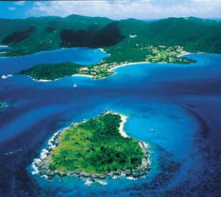
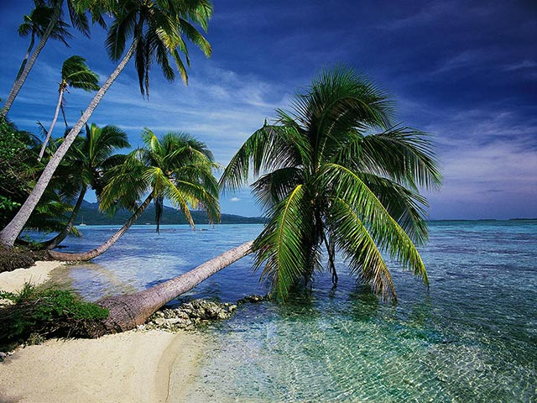
The environment
Island life

Slide 2
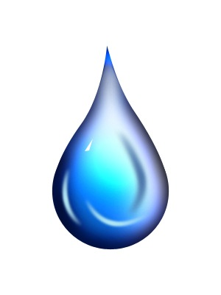
One out of ten people lives on an island . What is an island ?
It’s a piece of land that is surrounded by water. It is smaller than a continent and larger than a rock.
There are islands all over the world – the pacific ocean has 30.000 islands .
Islands are very special places and each one has its own plants and animals .
Madagascar, off Africa , is an island where there are tropical forests, deserts, mountains, rivers and lakes . It has more wildlife than a continent.

Slide 3
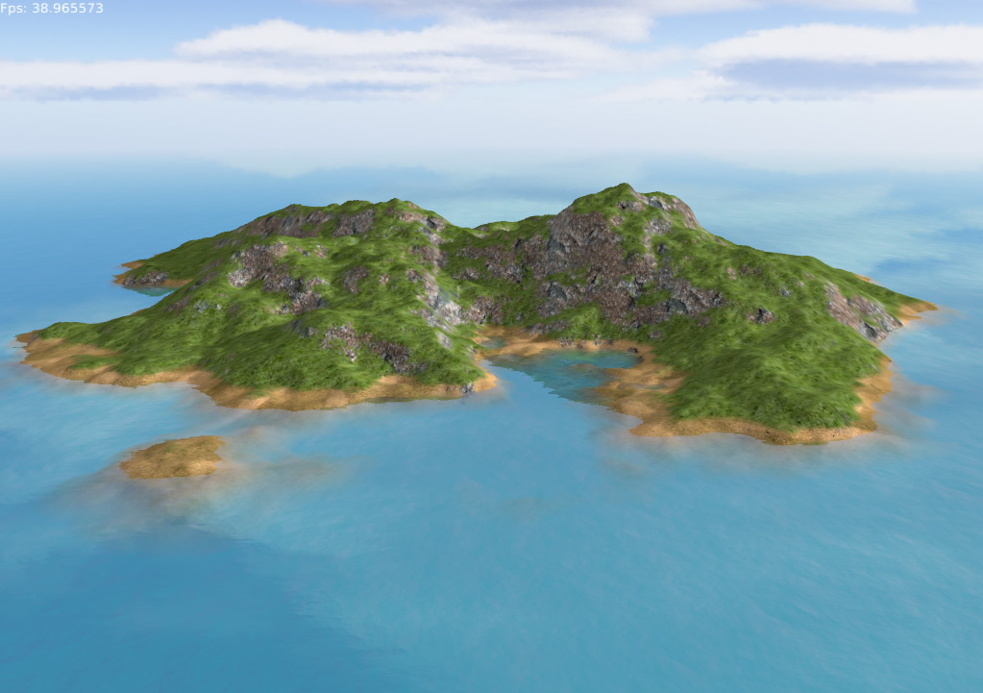

Slide 4
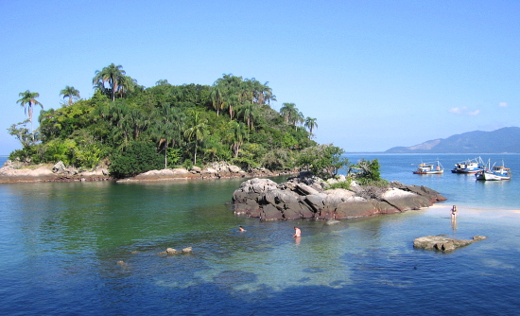
Island develop life slowly . Seeds are brought by wind ,sea or birds . Animals that can fly come next. Land animals are the last to arrive. then, over millions of years, the plants and animals which live on islands change. For example, in Hawaii, butterflys become heavier. This stopped the wind carrying them into the sea.

Slide 5
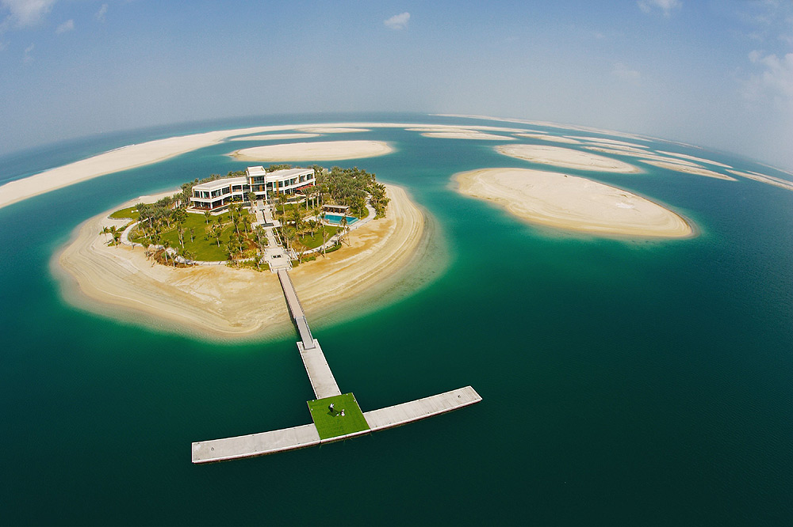
dubai

Slide 6
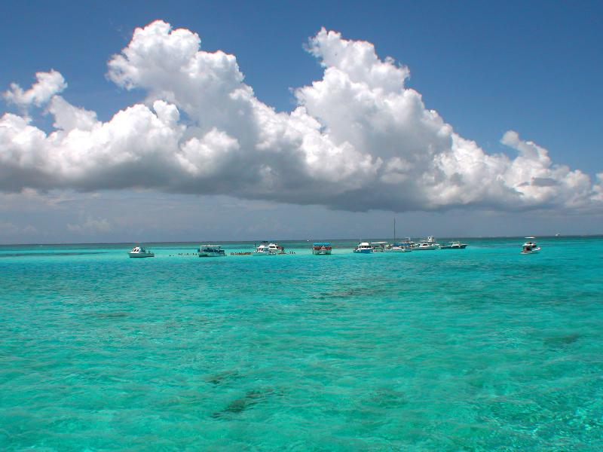
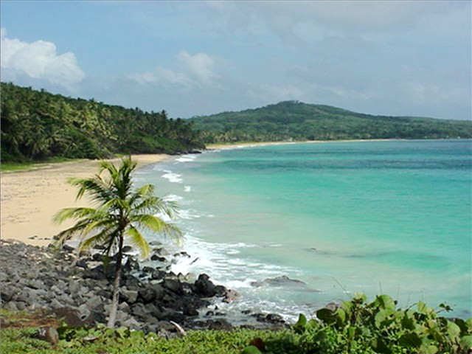
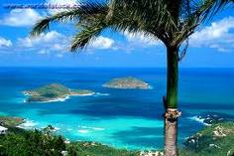
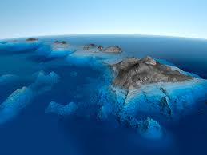
Hawaii….

Slide 7
In 1963, a volcano erupted off the coast of Iceland near the Arctic circle, and over the next two days Surtsey island was born . Scientists had the chance to study this new island where there were no animals or plants. Forty-five years later, 69 kinds of plants are growing there and there are many insects and birds.

Slide 8
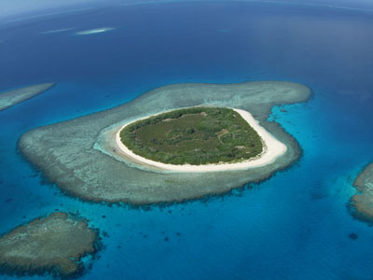
Surtsey island

Slide 9
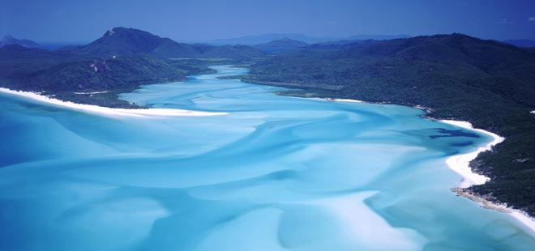
In the past, the people who lived on island changed them. On one island, local people cut down the trees to build boats. They used the boats to catch fish. When there was no more wood people died. Visitors who sailed to islands also changed them. For examples, ships introduced goats which destroyed native plants and animals.

Slide 10
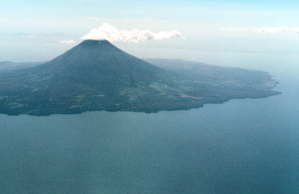
These days many of the animals that are found on islands are in danger. Of all the birds which became extinct in the last 200 years, most lived on islands. The orang-utan lives in the rainforests of Borneo and Sumatra in the Far east, where people are cutting down the forests and destroying their home.

Slide 11
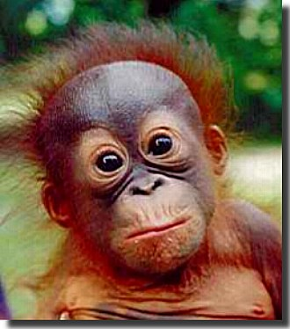
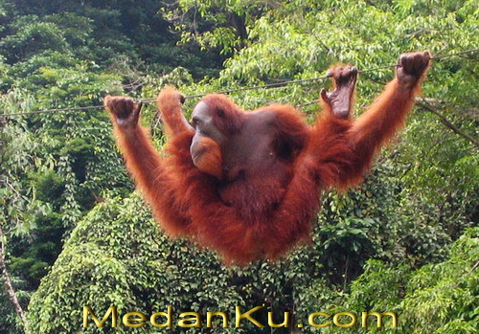
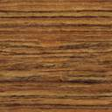
ORANG-UTAN

Slide 12
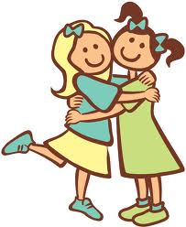
MADE WITH LOVE BY
ELISAR SAL7A
ZEINAB KA7LA

