Slide 1
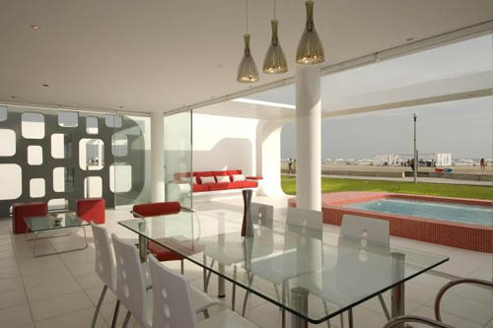
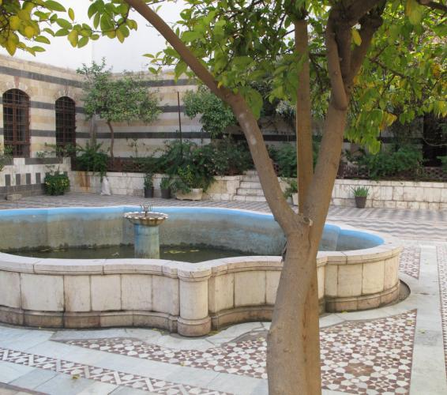
Houses
Old and now

Slide 2
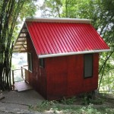
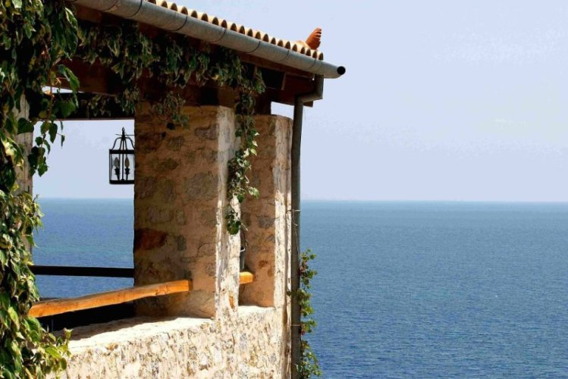
Houses
Take for instance the poor family. They all lived in one room. In fact their house only consisted of one room and they sometimes brought in their animals too to keep them safe from predators.

Slide 3
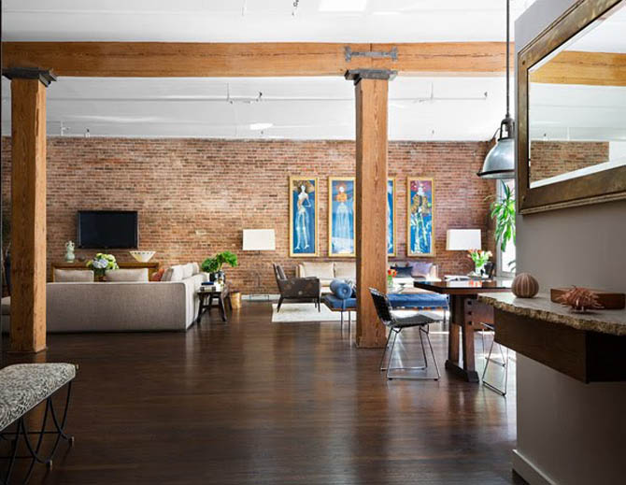
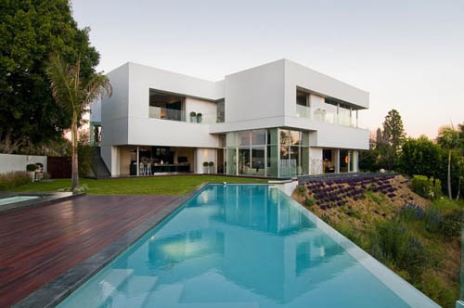
And in the rash family they live about three people in the big castle and they had a huge furniture and fantastic design inside the castle. Some times they brought many animals to guard them and put it in a house alone out the castle .

Slide 4

The End
لانا الحبال
The End

